Slide 1

BIG DATA
&
CORRUPTION RESEARCH
IN public procurement
Luis García Vargas
César Garzón
École nationale d’administration publique (ENAP)
Pierre-André Hudon
Université Laval
International Megaprojects Workshop
June 12-14, 2019 – UQAM – Montreal

Slide 2
The problem
Up until now, corruption research focused on perception
  For example: Transparency International’s Corruption Perception Index
What if there was a way to detect corruption “objectively” using big data?
Public procurement is an ideal field in which to use big data related techniques because of the abundance of publicly available information
International Megaprojects Workshop
June 12-14, 2019 – UQAM – Montreal

Slide 3
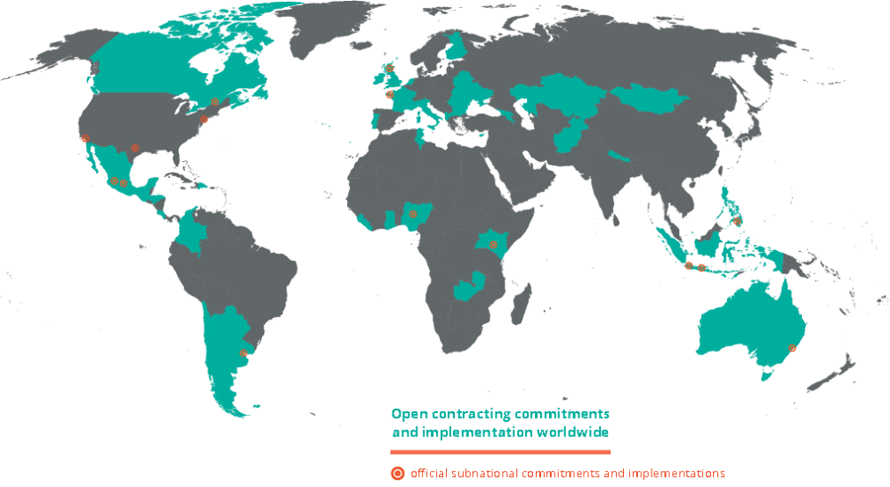
Big & Open Data:
The FUTURE of public procurement
US$9.5 trillion per year (15% of global GDP)¹
20-25% lost to corruption²
https://www.open-contracting.org/why-open-contracting/
2. https://www.open-contracting.org/contratacion-abierta-por-que/?lang=es
International Megaprojects Workshop
June 12-14, 2019 – UQAM – Montreal

Slide 4
Two frameworks for detecting corruption and collusion
DETECTING CORRUPTION
DETECTION COLLUSION
Based on the works of:
  Fazekas & al. (2013…2018)
  Ferwerda & al. (2017)
  World Bank (2016)
Public procurement corruption techniques and schemes are identified, modelled and converted into individual indicators
When a contract is flagged by many indicators using an index score, it becomes suspicious
Based on the work of:
  Fazekas (2016)
  Kaway, K. et J. Nakabayashi (2014)
  Clark et al. (2015)
  Reeves-Latour (2016)
Suspicious bidding patterns and market structures are identified using social network analysis
Suspicions of price fixing are identified from bid data using similar techniques as the ones used for corruption detection
International Megaprojects Workshop
June 12-14, 2019 – UQAM – Montreal

Slide 5
CORRUPTION TECHNIQUES AND EXAMPLES OF INDICATORS
LIMITING THE NUMBER OF BIDDERS
Only one bid received
Lengthy bidder eligibility criteria
Geographical restrictions
CORRUPTING THE BID SELECTION PROCESS
Only one compliant bid
Call to tender cancelled
Lengthy bid evaluation criteria
EX POST CONTRACT CHANGES
Changes during contract execution
Contract extension(s)
Ex post contract value (Δ)
International Megaprojects Workshop
June 12-14, 2019 – UQAM – Montreal

Slide 6
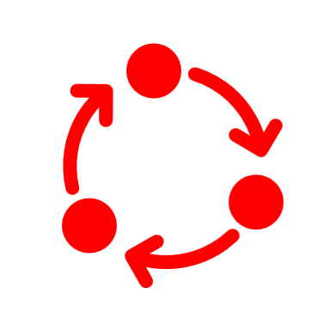


SIGNS OF Collusion AND
EXAMPLES OF INDICATORS
SUSPICIOUS
BIDDING PATTERNS
SUSPICIOUS
MARKET STRUCTURES
SUSPICIONS
OF PRICE
FIXING
Winning rate too high
Cyclical winning
Missing bidders
Superfluous losing
bidders in network
Overly concentrated market structure
Falsely stable market structure
Equal spread between bid prices
Standard deviation of bid prices
Bid price range
SOCIAL NETWORK ANALYSIS
International Megaprojects Workshop
June 12-14, 2019 – UQAM – Montreal

Slide 7


Application with real world data
Quebec’s Treasury Board Secretariat publishes public procurement contracts data since 2009:
  Over 200 000 contracts
  Over 600 000 bids
The database’s fields give very precise information about:
  The bidders (names, IDs, etc.)
  The bids (values, dates, etc.)
  The contract (ID, dates, values, addenda, etc.)
From these precise information, corruption and collusion suspicion index scores (based on indicators) can be calculated
EXAMPLES OF AVAILABLE DATA
International Megaprojects Workshop
June 12-14, 2019 – UQAM – Montreal

Slide 8
Developing An integrated tool
1. Identify corruption and collusion schemes
2. Create an indicator for each scheme
3. Perform social network analysis
4. Calculate a score per indicator for each contract
5. Compute an index score for each contract or sector
6. Identify suspicious contracts or sectors
Eventually:
  Intelligent parsing of call to tender documents
  Machine learning to identify which contract are suspicious of corruption based on automated social media/press monitoring
  Machine learning based on historical data of corrupt contracts
International Megaprojects Workshop
June 12-14, 2019 – UQAM – Montreal

Slide 9
What does it mean for megaprojects?
In megaprojects, patterns are harder to detect:
Fewer contracts with many subcontracts
Projects are harder to compare because they are unique
Procurement often done by private consortia’s subcontractors
Complex coordination structures:
  Multiple public bodies and intricate private consortia involved
Multilevel financing and disclosure:
  Country, state/province, municipalities, supranational entities, multilateral institutions
However, some solutions may exist:
“Widening the field” – using an international data base of megaprojects contracts
Focusing on subcontracts – requires changes to disclosure practices
Pushing for more big data collection from multilateral financing agencies
International Megaprojects Workshop
June 12-14, 2019 – UQAM – Montreal

